Slide 1

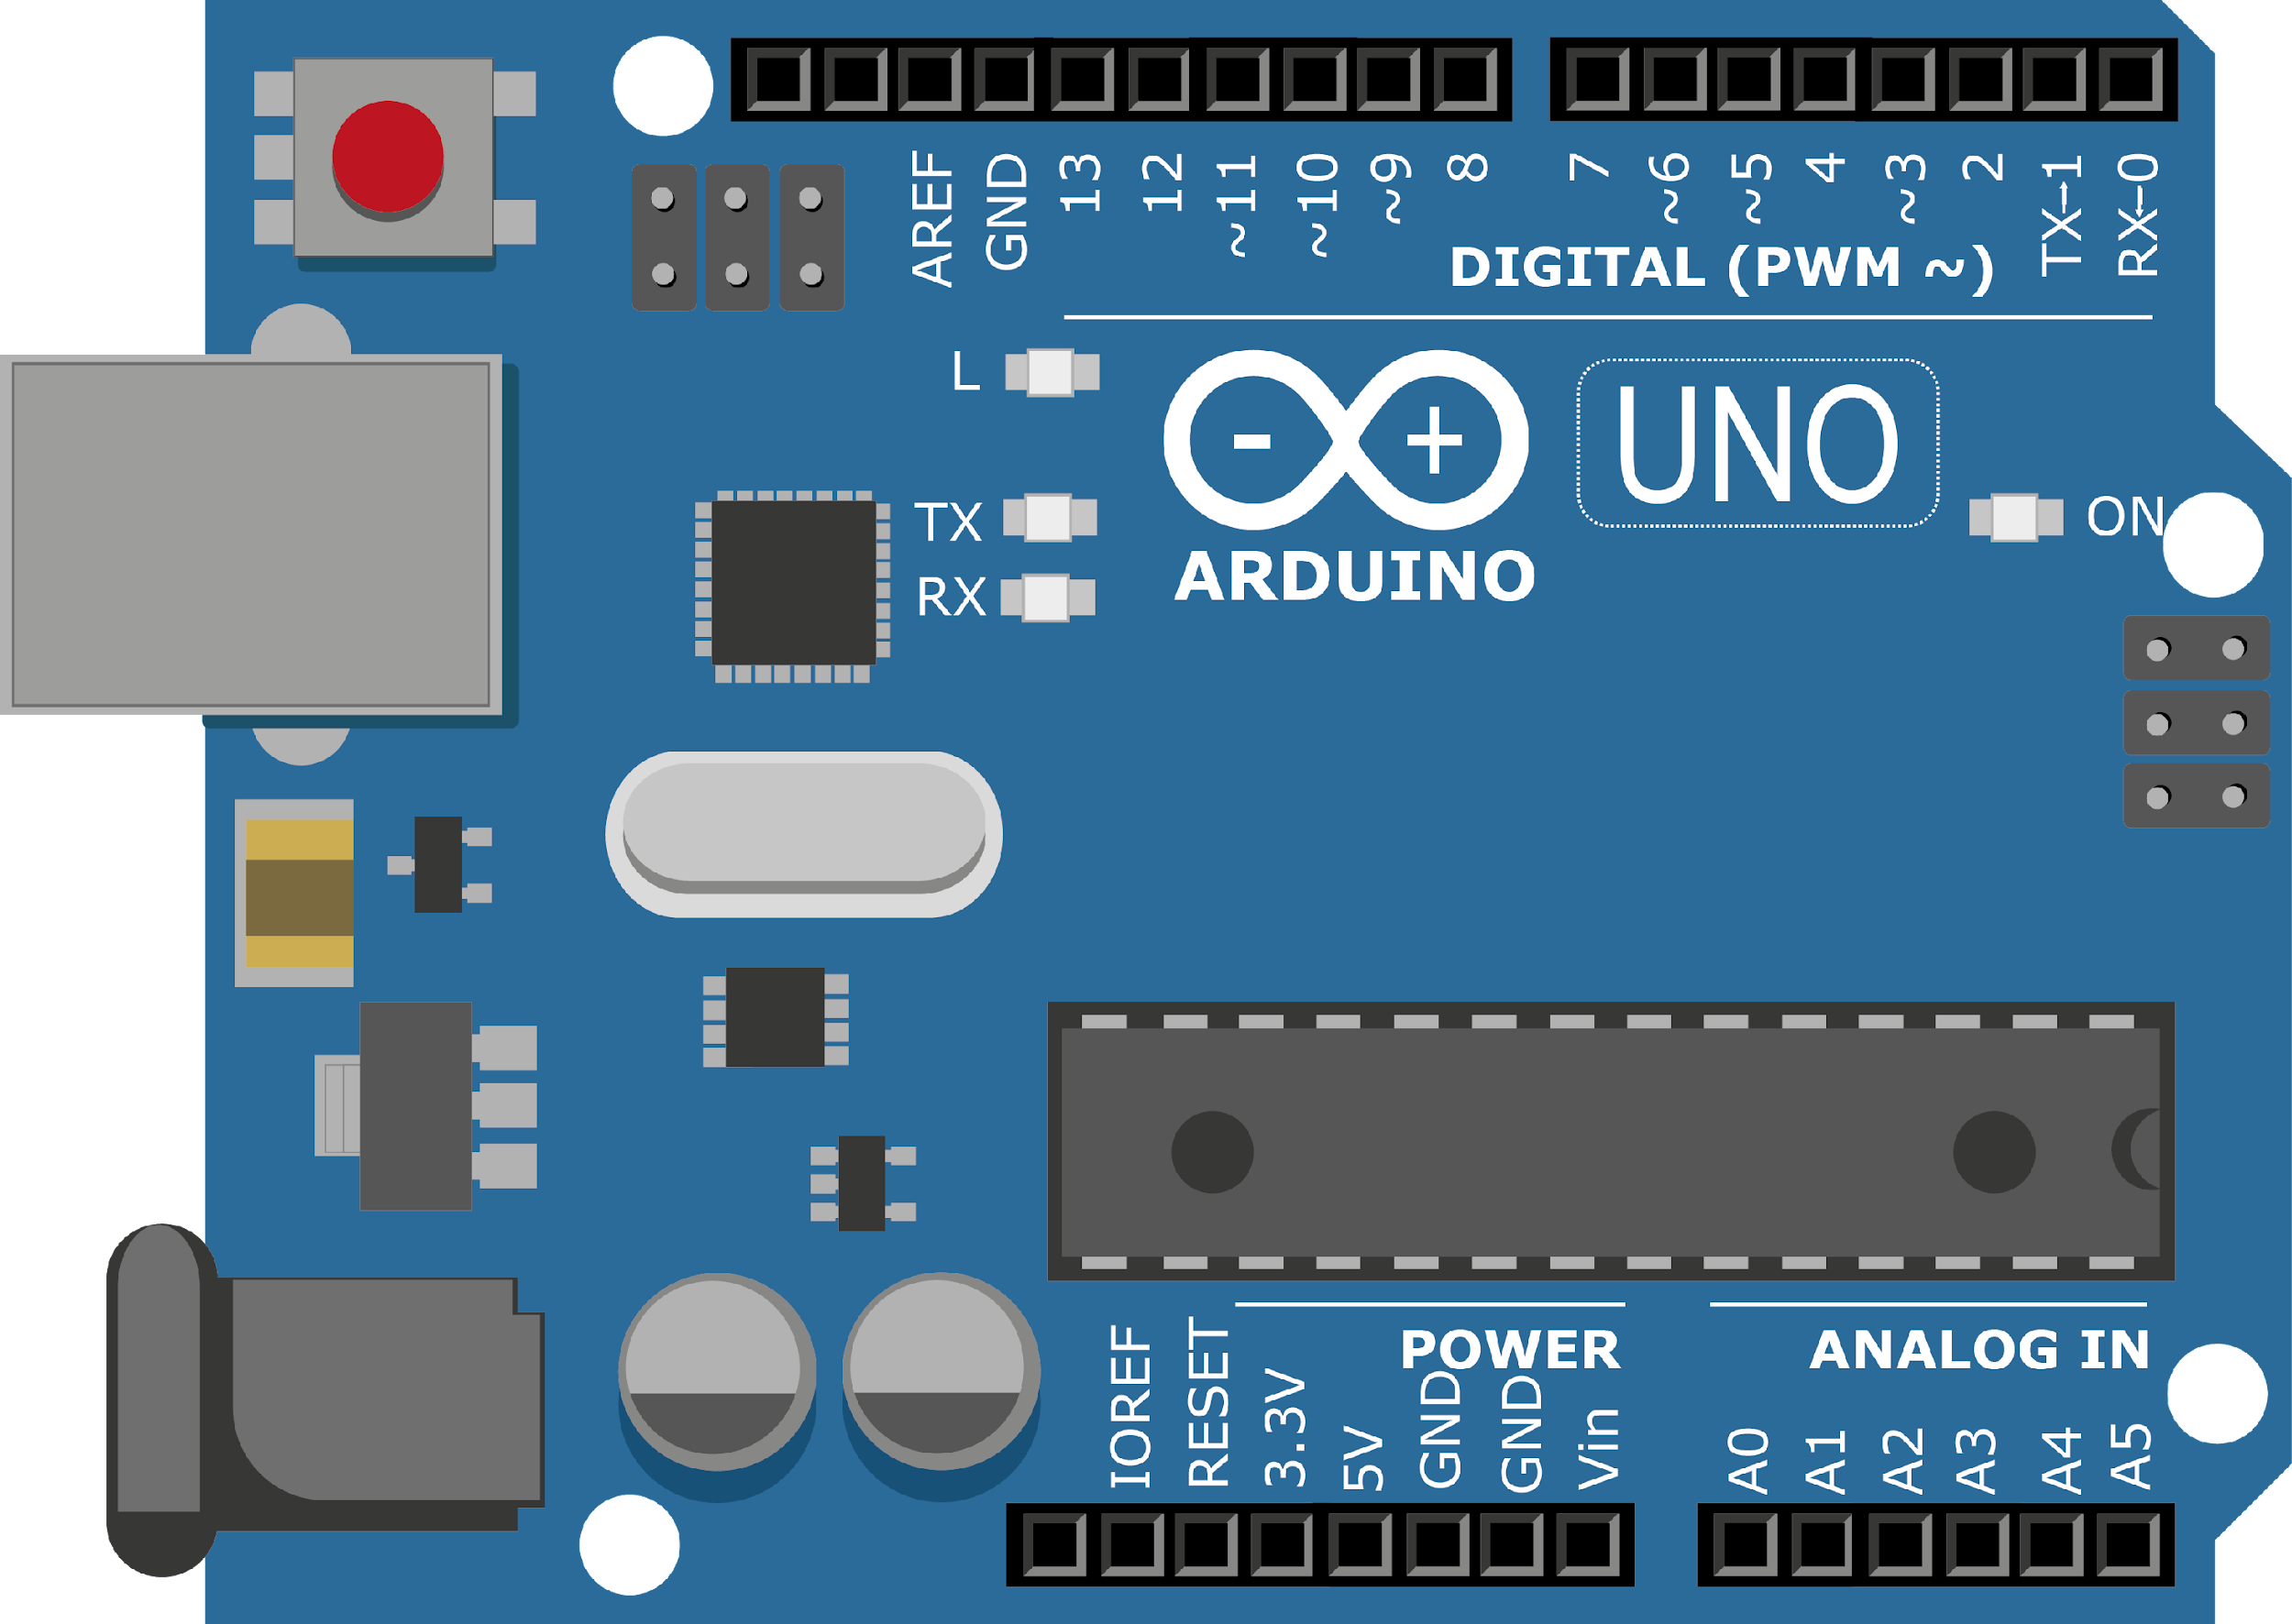
ARDUINO MASTER CLASS
09
Temperature Monitoring System | Analog Sensor

Slide 2
9 AGENDA
02
03
01
Temperature detection
Temperature sensor
Q & A

Slide 3
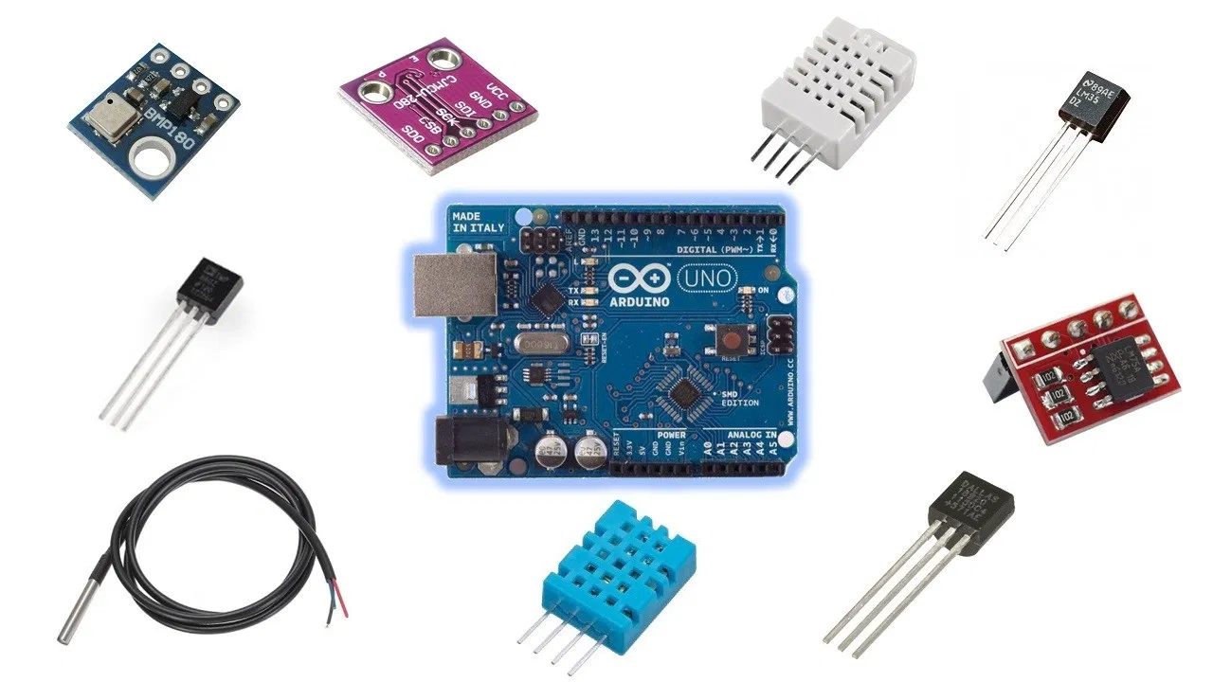
Temperature sensor
A temperature sensor is an electronic device that measures the temperature of its environment and converts the input data into electronic data to record, monitor, or signal temperature changes

Slide 4
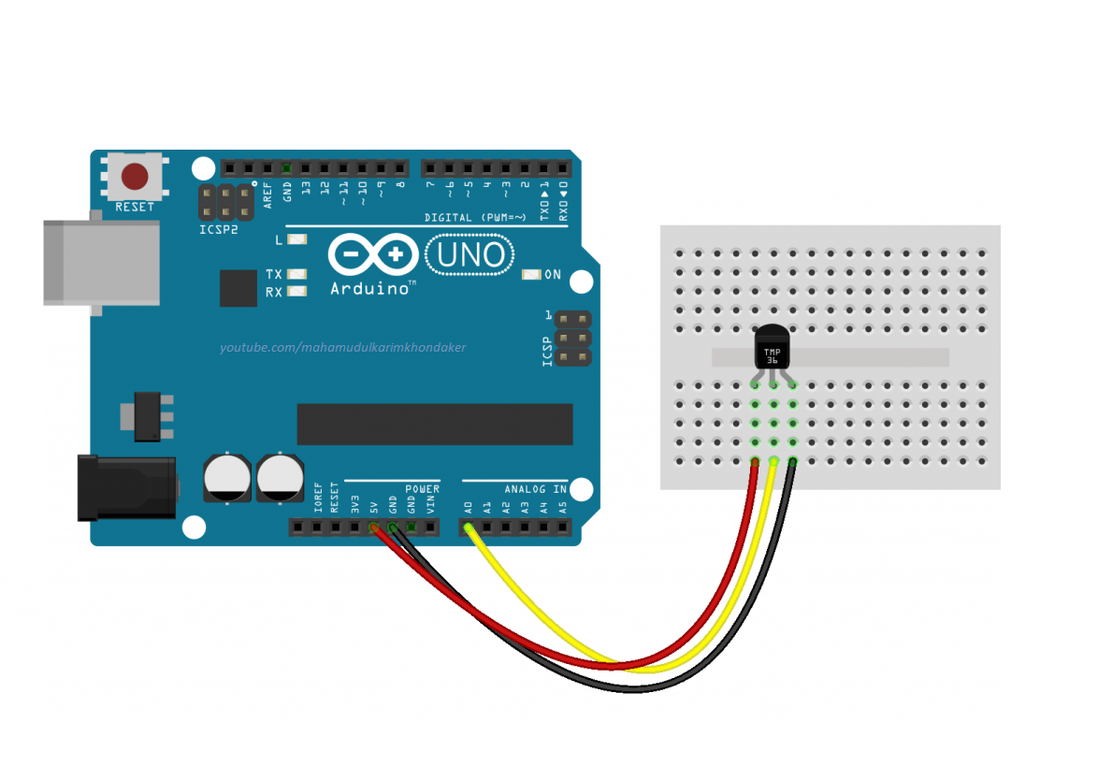
IR Sensor with Arduino

Slide 5

INTERVIEW QUESTIONS
What is meant by Flipflop?
What is the difference between timer and counter of microcontroller?
LM35 Temperature measurement range
A Flip-flop is a basic electronic circuit used for storing information in a digital machine. It is a bistable device. It means it has two stable states.
It has one or more inputs and two complement outputs.
Timer counts internal clock cycles while counter counts external events.
-55°C to 150°C

Slide 6

THANKS!

